Slide 1
Introduction to Generative AI
A practical introduction for beginners
Presenter: Marlon Jones (CTL)
Notes:
Welcome, Introductions & Housekeeping
Good morning. Thank you all for coming to our AI Boot camp session. We are very happy to have you with us today.
I’d like to begin by acknowledging the indigenous owners of the land on which we are collectively gathered. I pay my respects to Elders past, present and emerging. I acknowledge that sovereignty was never ceded and that this always was and always will be aboriginal land.
My name is Marlon. My pronouns are he/him and I’m an educational designer with CTL here at SCU. I’ll start by confessing that, I’m not an AI expert. My background is in teacher training and learning design. That said, I am an educational technology nerd, and I’ve spent the past year or somewhat obsessively learning about the AI tools I’ll show you today, so very happy to walk you through the basics.
Some housekeeping. Today’s session is being recorded. After the session, you will be able to access the recording, the slides and any resources via Scout.
We have over 250 attendees here today, which is fantastic, but that means we may not have time to respond everyone’s questions. If do you have questions during the session, please feel free to add them to the chat. I’ll try to check in when we can. We’ll also try to leave some time at the end for Q&A.
I’ll be moving quickly today as there is a bit to cover. So, I recommend that while I’m demonstrating, just watch. Don’t worry about trying to follow along at home. You’ll have access to the recording, and we’ll cut that up so you can skip ahead to the sections that are most relevant to your needs.
I’ve also created a Padlet of resources for you, which will include today’s slide as well as links to relevant tutorials, free courses, prompting guides. Everything I wanted to know when I was first starting out.
This session is designed to be a practical introduction to AI chatbots for beginners. We’ll spend most of our time looking at ChatGPT and Copilot and how they work. So, if you have never used these tools before, or you have very limited experience, then this is a good session for you.
Conversely, if you are already familiar with the basic features and functions of these platforms, then you’ll probably know a fair bit of what I’m going to cover today. In that case, feel free to drop out at anytime, but be sure to check out the resources which have some more advanced tutorials.
Finally. we’d love to know what types of training you’d like moving forward. So, we’ve put together this Zoom poll, and your answer will help us to provide target training in future. [Start Poll].

Slide 2
What are we doing today?
01 What is Generative AI?
02 Which AI chatbot should I use?
03 How to use ChatGPT
04 How to use Microsoft Copilot
05 How to write an effective prompt
06 Where to get help
07 Q&A
Notes:
What are we doing today?
So, what are we going to do today?
First up, we’ll cover what Generative AI is, how it works, and how students are using it.
Next, we’ll clarify which AI tools SCU would like you to be using.
Then, we are going to compare two popular chatbots: ChatGPT and Copilot. For each tool, I’ll give you a brief tour of the interface and highlight the main features and functions.
I’ll give you a simple formula you apply to write effective prompts.
If we have time, I’ll show you how you can generate videos with a ChatGPT and use Copilot to respond to your Outlook emails.
With that said, nothing I’m going to show you today is very technical. Anyone can use these AI tools, but there’s lots to cover so let’s get started.

Slide 3
Notes:
What is Generative AI?
To start, I want to show you a 2-minute clip. In this video, we’ll hear from Ethan Malik, who is a prolific AI researcher and educator. You should definitely follow Ethan on LinkedIn for great insights into the role of AI in higher education. In this clip, he provides a clear explanation of what Generative AI is and how it works. So, sit back, enjoy and I’ll see you in 2 minutes (See 02:06 – 0:4:57 https://youtu.be/t9gmyvf7JYo?si=XaY9fh_2-2nQPl5J)
Ok so now we know what Gen AI is and how it works, let look at what its capable of.

Slide 4
Notes:
What can Gen AI do?
This next clip is also worth a watch because it gives a quick overview of what ChatGPT is currently capable of and demonstrates how students are typically currently using these tools. (x1.5 start 0:16 – 5:38)

Slide 5
AI Chatbot Comparison
Which AI chatbot should I use?
Logo | Company | Chatbot | Default Model | Features | Best for
 | Microsoft | Copilot | GPT-4 | MS 365 apps | Data Security
 | Open AI | ChatGPT | GPT-3.5 | Chat memory & customisations | Ongoing Projects
 | Perplexity | Perplexity | GPT-4 | Real-time data | Academic Research
 | Anthropic | Claude | Claude Sonnet 1 | Artifacts | Interactives
Notes:
Which AI tool should I use?
So, I think we all agree that it’s important to know how to use AI tools. But which tools should you be using?
SCU’s official position is that you are welcome to use any AI platform you like.
However, if you are working with information that is sensitive or protected, then the recommendation is that you use Microsoft Copilot, and that you log in using your SCU details.
The reason for this is that SCU has enabled Commercial data protection. This means that when you log into Copilot with your SCU account, your data will be private and encrypted.
By default, Microsoft won’t use your data to train it’s AI and anything you input into the Copilot chatbot cannot be traced back to you or SCU.
Having said that, this level of data security comes with some trade-offs in terms of Copilot’s functionality. We’ll look at what those limitations are in more detail a bit later on.
Apart from Copilot, what other AI chatbots should you consider?
For those of you who are brand new to AI, a good place to start is ChatGPT. It’s user friendly, it’s versatile and I’m guessing that many your students are already be using it.
The other reason I like GPT is because, is because, unlike Copilot, it has the ability to remember information about you, which makes it more suited to ongoing project work and routine tasks.
Two other chatbots you might want to explore are, Perplexity and Claude. Now, we won’t go into detail with either of these tools today, but I do think they are both worth mentioning.
Perplexity, because it work like a search engine that a chatbot, meaning it accesses data in real-time, providing you with information that is current.
And Claude, because of a new feature they just introduce called artifacts, which allows you to create custom interactives, such as quizzes, websites and games, without any knowledge of coding. Which is a real game changer for online course development.
With that said, each of these tools has various pros and cons. We’ll cover some of those today, but I recommend you sign-up for free accounts and just start experimenting to see which product suits you best. I’ve put links to each of these tools, as well as simple tutorials in the resources, so be sure to check them out.
With that said, let’s start using ChatGPT.

Slide 6
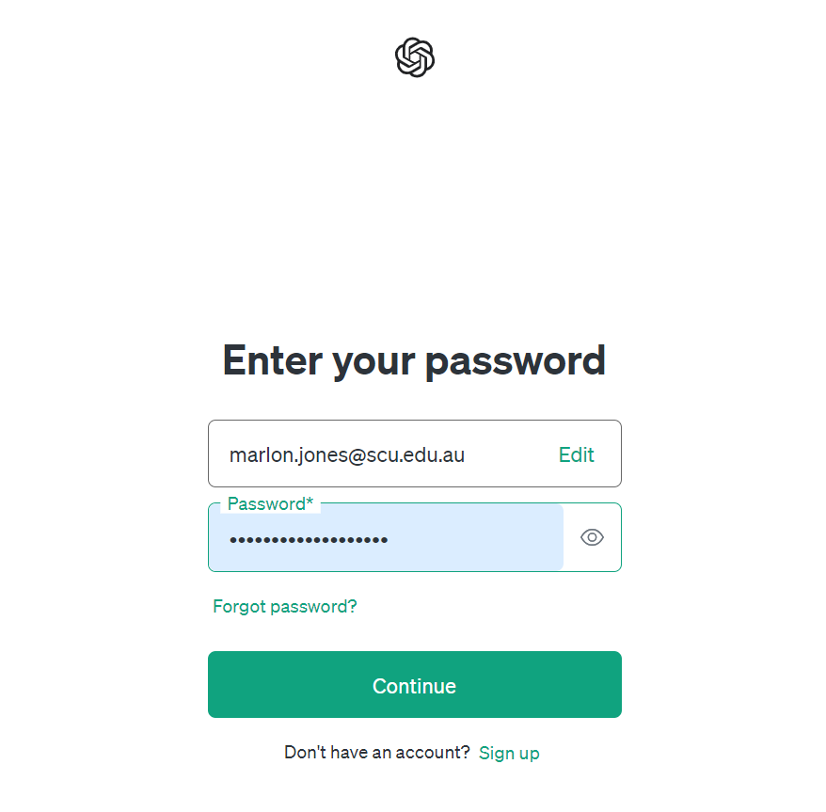
Sign-up to ChatGPT
Go to https://chatgpt.com/
Create sign-up to create free account
SCU does not have a ChatGPT enterprise subscription
Notes:
Sign up to ChatGPT
To access the ChatGPT, go to chatgpt.com.
I recommend you sign-up for a free account, as this will give you access to features that you’re going to want, such as the ability to upload files.
When you sign-up you can use your SCU email, just be aware that SCU doesn’t have a subscription to ChatGPT, meaning that you will be accessing the free version.

Slide 7
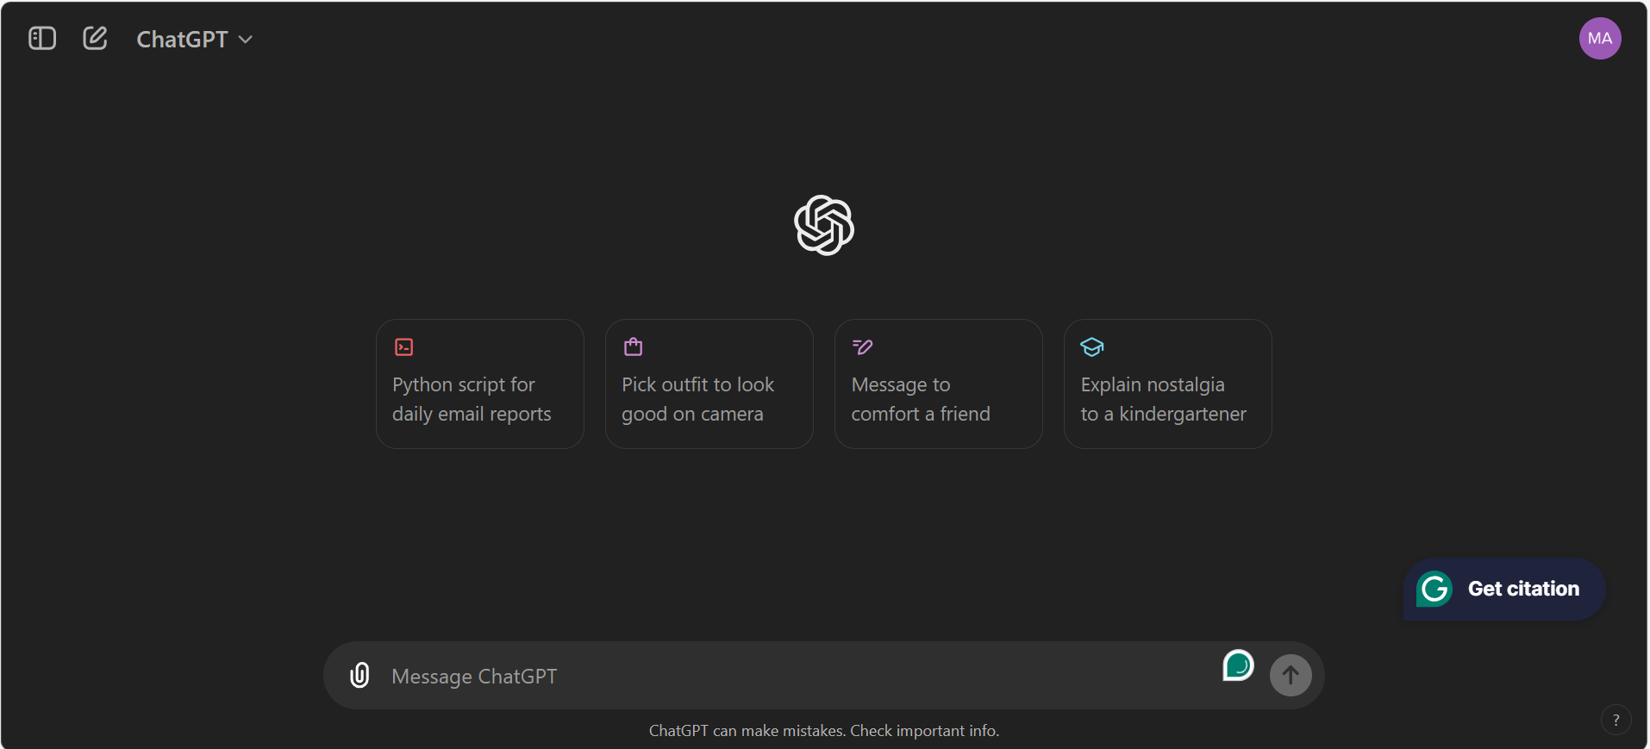
Getting started with Chat GPT
Notes:
Getting Started with ChatGPT
I’m sure many of you will have used GPT before, but since today is for beginners, I want to take moment to do a quick tour of the interface, so we all know the basics.
Here is where you will enter your instructions and upload files.
Let’s try a suggested prompt and see what it comes up with. [Act as a Historian. In one paragraph, explain why the Roman Empire collapsed. Provide sources for your response and use an informative tone].
Sometimes you’ll see links to source material. Just be aware the even though ChatGPT provides weblinks, it’s not actually accessing the internet in real-time. That’s because ChatGPT is trained on static data. Essentially, the developers take a snapshot of the internet at a certain point in time and feed that information into the AI model. ChatGPT models can only access their pre-trained data, so, keep in mind that it won’t necessarily give you the most current or accurate information.
Below each output you’ll see five icons. They are read aloud, copy response, regenerate response, response feedback and change AI model.
The first couple are self-explanatory but let me quickly show you regenerate and change model.
So, let’s say I’m not happy with the AI’s output for whatever reason. I’ll ask it to regenerate the response. And here is an alternative output to my previous question.
We can continue regenerating different responses, and toggle between, them until we find a version you like.
Let’s say I like the 2nd response better, at this point we can add a new prompt, and the AI will base the subsequent conversation on the 2nd option.
If you don’t like the direction of the conversation, you can go back and edit a previous prompt. Just keep in mind that when you edit a previous prompt, you’ll lose any subsequent conversation.
The change model function is accessible here and here. Let me explain how it works.

Slide 8
Open AI’s Large Language Models (GPT)
GPT-3.5
Slowest
GPT-4
Standard
ChatGPT Plus
ChatGPT Free
Text only
Text & image
GPT-4 Turbo
Fastest
ChatGPT Plus
GPT-4o
Most Powerful
Multimodal
ChatGPT Enterprise
Multimodal
Notes:
Open AI’s LLM (GPT)
As you may recall all AI chatbots are powered by a Large Language Model (LLM).
Open AI calls its model ‘GPT’. Other companies have their own model for example Google has Gemini and Anthropic has Sonnet. Microsoft, incidentally, uses Open AI’s model GPT.
So, as these companies continue to train and improve their models, they release new versions with enhanced capabilities in terms of speed, accuracy, power, energy efficiency and multimedia content generation.
Generally speaking, the higher the model number, better the model. So, GPT-3.5 is an older, slower and generates text.
GPT-4 is newer, more powerful and generate multimedia.
All ChatGPT users, have the ability to switch between models. So even with a free account, you’ll be able to access the GPT-4 models
However, as a free user, your access to the more advanced models is quite limited. You might get around 10-20 prompts before you hit your usage limit. At which point you’ll default back to GPT-3.5.
Now, 3.5 is a perfectly capable model. You might find its more than sufficient for you needs.
If you subscribe to ChatGPT Plus for $30 per month, your default model will be GPT-4, and you’ll have access to Omni and Turbo. You’ll still have usage limits, but you’re less likely to reach them within a day of heavy use.
If you don’t want to pay the subscription fee, then a good thing to know is that the default model for Copilot is, GPT-4. So, ny default it’s faster and more capable than the free default version of ChatGPT.
Ok, so now we understand model, let’s talk a little bit about effective prompting.

Slide 9
Prompt Formula
Task
Context
Exemplar
Persona
Format
Tone
PROMPT
Act as an educational designer. (Persona)
You are creating a lesson plan for a first-year undergraduate course in psychology. (Context)
Outline an interactive classroom activity to help students understand the concept of cognitive biases. (Task)
Review the attached document which provides a sample activity. (Exemplar)
Generate an outline for a new activity, specify the activity aim and objectives. (Format)
Use an instructional and informative tone. (Tone)
Notes:
Prompting Formula
For anyone who might not know, a prompt is simply the command or question you give to the AI. So, really there’s no wrong way to prompt.
However, prompt engineering is the skill structuring a prompt in order to optimise the AI’s output.
So, in other words, there is no wrong way to prompt, but there is a right way.
Now, prompt engineering can get surprisingly technical. If you want to take a deep dive, I’ve added a good prompting guide to the workshop resources. It covers a range of prompting techniques such as Few Shot prompting and Chain of Thought reasoning.
But for those of you who are short on time, the essential techniques have been condensed into a simple formula that can use to structure your prompts effectively.
There six components to the formula. They are Task + Context + Exemplar + Persona + Format + Tone.
Let me give you and an example of a prompt that applies our formula.
“Act as an educational designer creating a lesson plan for a first-year undergraduate course in psychology. Outline an interactive classroom activity to help students understand the concept of cognitive biases. Review the attached document which provides an activity exemplar. Present an outline for the activity, specify the aim and learning objectives. Use an instructional tone.
Now, it’s not necessary to include all six components in every prompt, but it’s worth noting that the formula is written in order of importance. Think of it this way, to write an effective prompt it is:
Essential to include the TASK
Important to include CONTEXT, EXAMPLES and PERSONA
Helpful to specify the desired FORMAT and TONE
Let’s get back to our tour

Slide 10
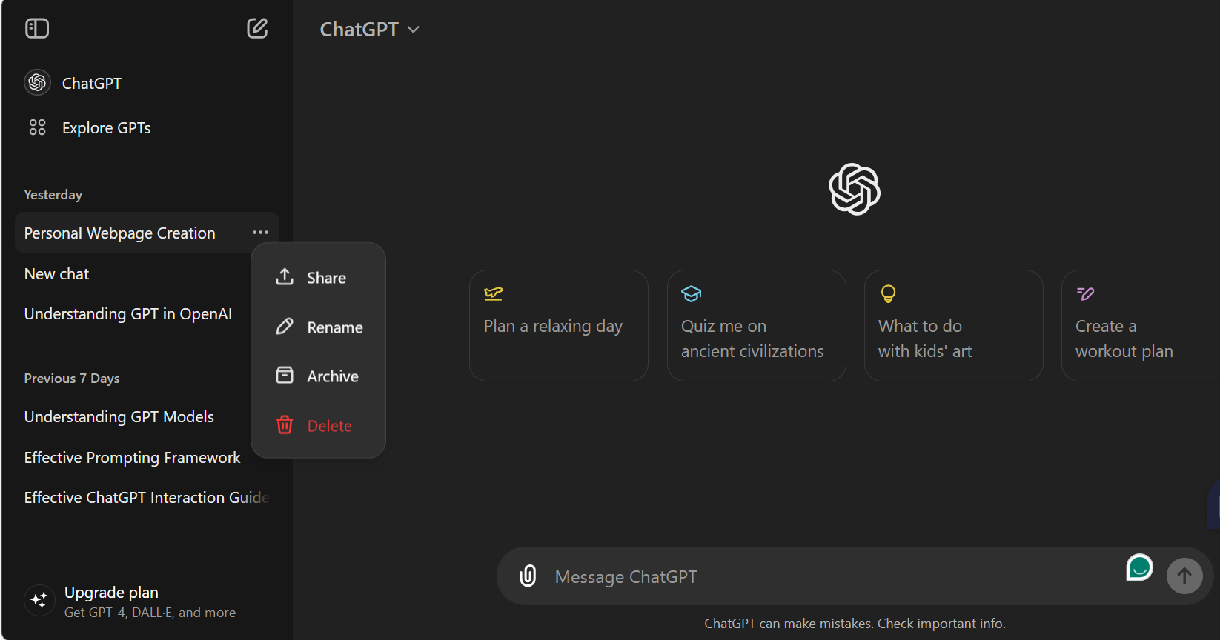
Start, rename, delete and archive chats
Notes:
Start, Rename, Delete and Archive Chats
To start a new chat, select the pencil icon.
Here is where you open the side bar which will show you your recent chat history.
Select the three dots next to an individual chat, this will bring up options to share, rename, delete or archive an individual chat.
I recommend you go through a rename your chats, for the simple reason that ChatGPT doesn’t have a search function yet. So, this will help you to keep things organised.
To see your saved chats, we’ll go to the profile icon, settings, general, archived chats, manage. Here is your archive folder. From here can restore individual chats them to the workspace, or permanently delete them.

Slide 11
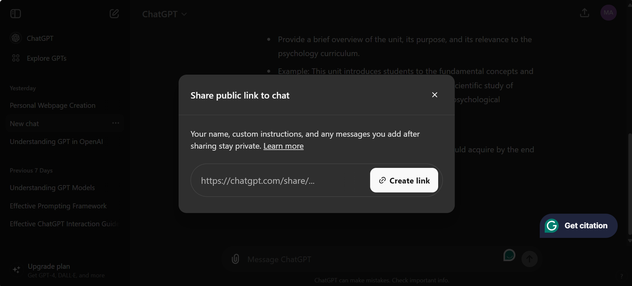
Share Chats
Notes:
Share Chats
One ChatGPT feature which I think is particularly useful for teachers is the Share function.
Until recently the only way to share a ChatGPT conversation with others was to take a screenshot of the chat. That’s changed now that ChatGPT has introduced Shared Links, which means you can generate a URL for each conversation.
To create a URL, either select the Share icon from the top right side of the screen, or you can select the three dots next to the chat from the side bar. [Create a URL, copy the link and open it in the web browser]
Note that anyone you share a link with will be able to view the conversation up to the point where it was shared. In other words, if you were to continue adding prompts to the conversation after you shared the link, the recipients won’t see your additional posts.
Similarly, the people you share the chat won’t be able to contribute to your chat. Currently, only ChatGPT Enterprise users have this capability.
So, now we have the basics down. Let’s move on to some more advanced features.
I think these features are some of the most powerful tools in the ChatGPT arsenal and ones to leverage if you are working with AI for complex or ongoing projects.

Slide 12
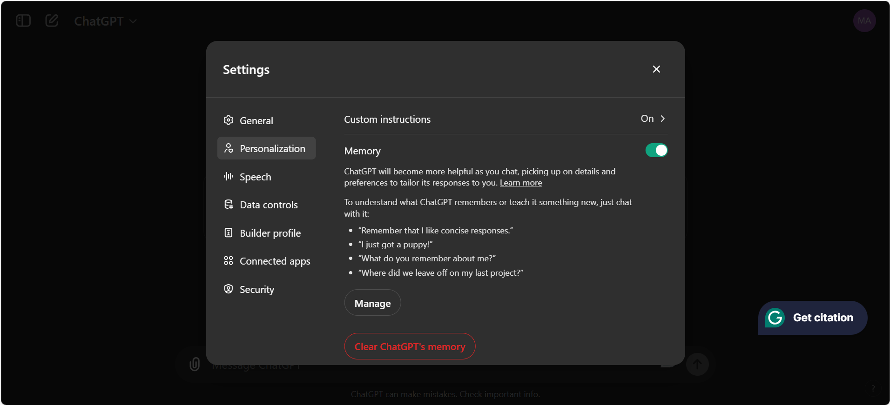
Chat Memory
Notes:
Chat Memory
The first is Chat Memory. By default, ChatGPT will remember certain information about you, such as your name, what projects you are working on and so on.
It will remember this information both within the context of a single chat and across multiple conversations. So, for example, if I’m working a psychology unit, ChatGPT may remember that I’m a psychology teacher in all of our conversations.
To enable or disable Chat Memory, go to the profile icon > Settings > Personalization > Memory > toggle on/off.
To see what information the AI remembers about you select Manage. From here you can delete specific memories or all memories.

Slide 13
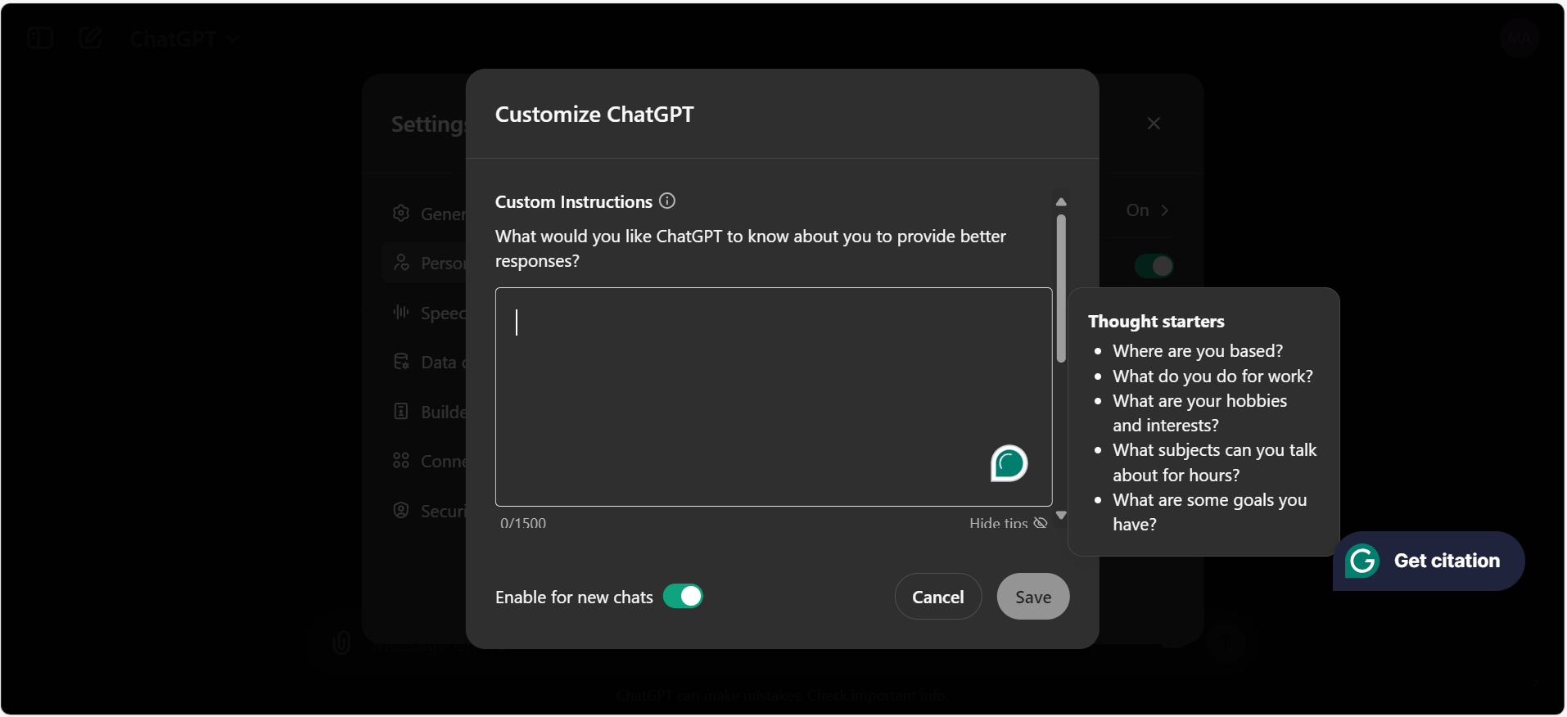
Custom Instructions
Notes:
Custom Instructions
Now instead of deleting these memories, let’s say you want ChatGPT to remember some information about you.
The reason this is helpful is because it will significantly reduce the amount of time you spend repeating yourself to the AI.
You can customise the information ChatGPT remembers about you using Custom Instructions. To access custom instruction, go into Settings > Personalization > Custom Instructions
Here is what you’ll see. The first question is “what would you like ChatGPT to know about you to provide better responses”. It helps if you can provide some context about yourself. So, for example, if you're a teacher, let it know. Specify the unit you’re teaching and the learning goals for that course. You get the idea.
The next question is “how would you like ChatGPT to respond?”For example, you could put in, "Language should be in Australian English. The tone should be friendly, instructional and informative”.
Now remember that ChatGPT is prone to hallucinations, meaning it sometimes presents false or misleading information as fact.
So, in custom instructions we can ask the AI to always inform us about the confidence level of its answer. For example: "When your answer includes facts, always provide a valid URL with the source for your answer. And if you speculate or predict something, inform me."

Slide 14
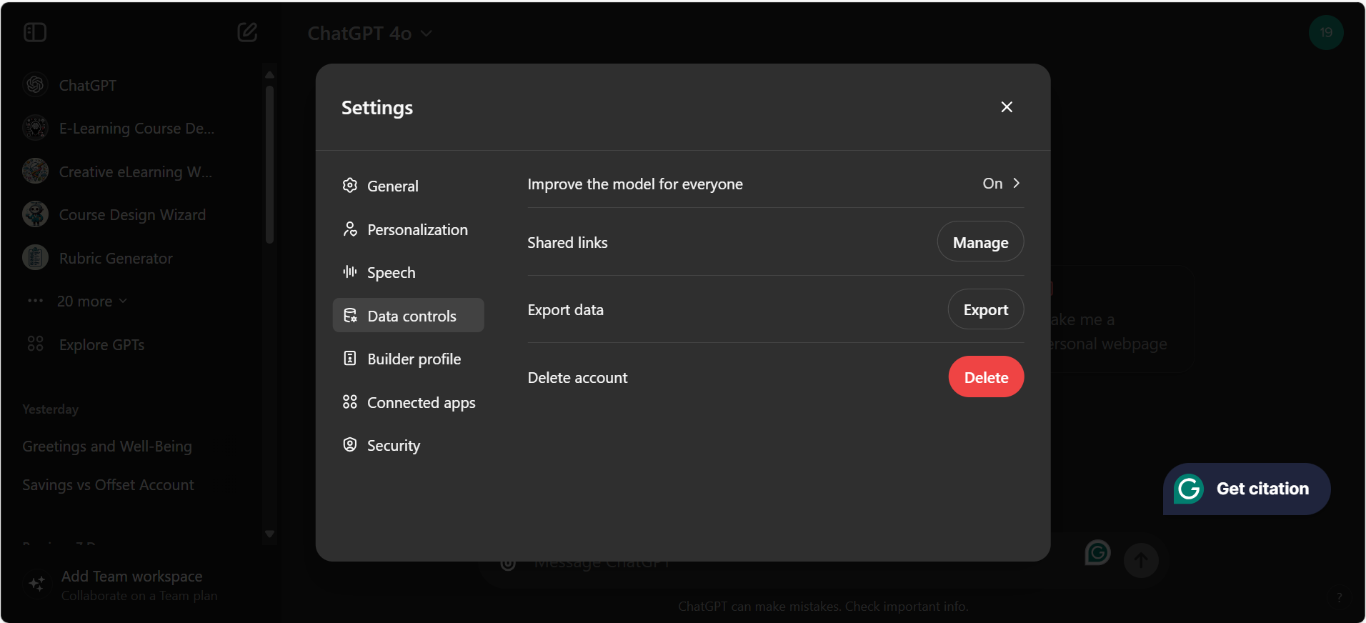
Data Controls
Notes:
Data Controls
While we are in settings, one more thing to be aware of is, that by default, Open AI uses your data to train it’s LLM.
If you do not want OpenAI using your data in this way, go into Settings > Data Controls > Improve the Model for everyone > Off
Even with this function disabled. I’ll caution you against uploading any personal, sensitive or protected data to ChatGPT. If you need to work with protected data, then switch over to Copilot.

Slide 15
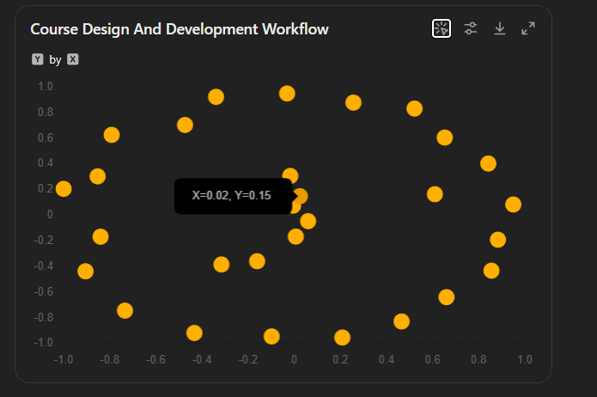
Output Formats
Notes:
Output Formats
We already know that its good prompting practice to specify the type of format you want the chatbot to generate. For example, generate a bullet point summary of this paragraph.
It’s worth briefly clarifying types of output ChatGPT can produce, as this changes depending on the model and subscription you are using.
Currently, the free version of ChatGPT, which use GPT model 3.5, can generate:
Text (i.e. bullet points, tables, quizzes etc).
Code
Math Equations
Common file types (PDF, Word, Spreadsheet etc)
What you won’t be able to do with 3.5 is generate images or multimedia. To do that you’ll need to use GPT-4 or higher.
In addition to the things GPT-3.5 can do, GPT-4 models can also generate:
Infographics
Mind-maps
and Interactive charts and data visualisations [Show examples]
It’s worth noting that, it is not currently possible to generate audio or video (MP4) in ChatGPT, even with a paid subscription. Open AI does have a platform that generates videos, called Sora. But you cannot directly access Sora through ChatGPT just yet.
If you want to generate AI videos using ChatGPT, it possible to do so with a paid third-party tool called In-Video.
To do this you’ll need access to the ChatGPT store.

Slide 16
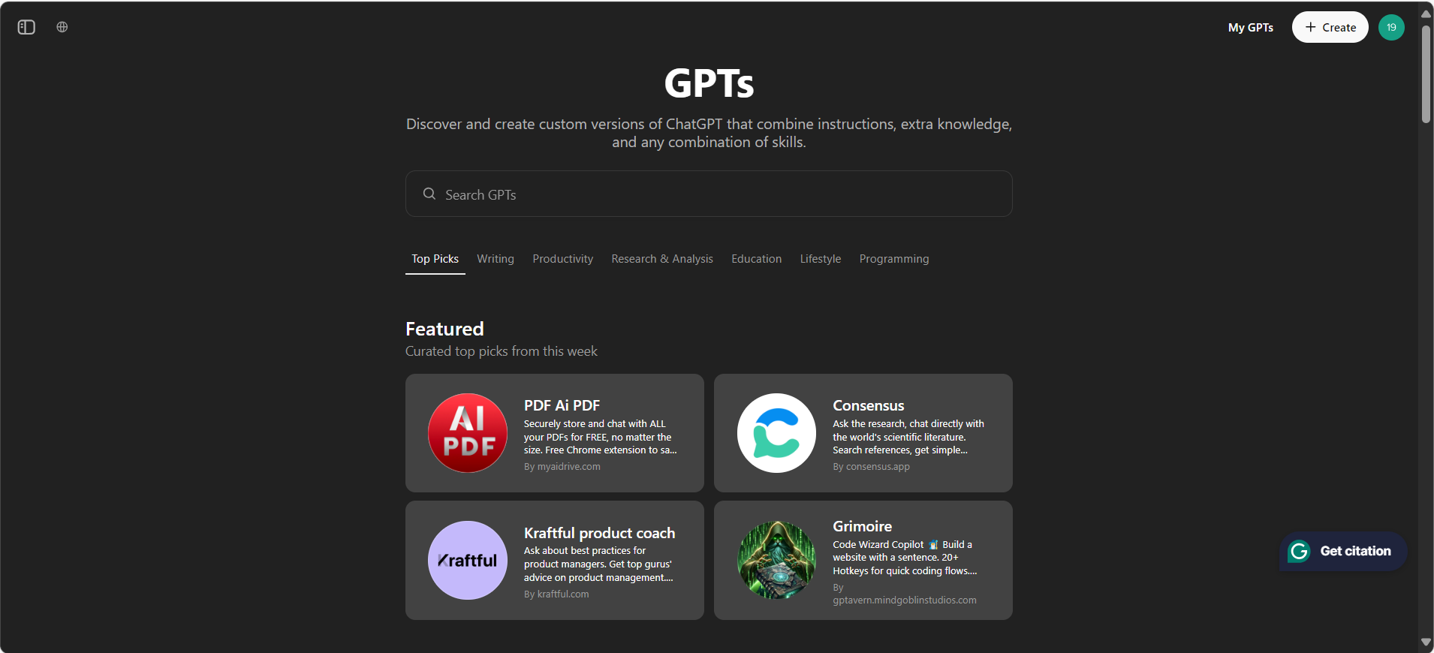
The GPT Store
Notes:
The GPT Store
This is the GPT store.
For anyone who doesn’t know. GPTs are customised version of the chatbot that have been trained for a specific task, for instance writing a resume, creating an assessment rubric or even generating a video.
The GPT store is a place where you can access pre-trained chatbots.
Until recently the store was only available to Plus subscribers. But now, it is apparently available to free tier users as well, although I’ve not been able to access it with my free account. Possibly because it’s at capacity.
To access the store, go to the side bar and select Explore GPTs.
In the GPT store, you can search for and start conversations with custom GPTs. So, for example, let say I need help creating a rubric, I can search for a ‘Rubric Writing’ GPT and then start a conversation with that pre-trained model.
You also have the ability to build your own custom GPTs, which is is great if you need help with a routine task or workflow.

Slide 17
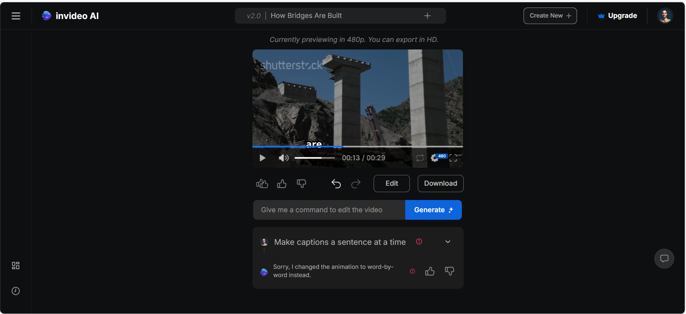
Generate Videos
Notes:
Create a Video with In-Video GPT
Here’s how you can create a video using a custom GPT.
Go to the GPT store and search for In-Video by In-Video.
Start a conversation with the GPT.
Enter your prompt. For example [Create a 60 second explainer video demonstrating how bridges are built. Make it informative and educational. Present in landscape. Use realistic footage and a female voice-over]. That will do for now. As always with prompting, the more detailed and specific you are, the better your results will be. But don’t worry because we can go back and modify our prompts.
Eventually, the GPT will provide you with a link to generate the video in In-video. Click the link,
You’ll need to sign up for a free account.
Wait for video to render. Here’s one I made earlier.
From here you can edit your prompts. Edit the video.
When you are happy, you can export the Mp4. Just be aware that if you want to remove the watermark, you’ll need to upgrade to a paid subscription which is around $30 per month.

Slide 18
Limitations of ChatGPT (free)
Struggles with complexity
Noticeable slow
Doesn’t generate images
Hallucinates
Information is not current
Notes:
So obviously there is a lot you can do with the ChatGPT. But it’s worth briefly highlighting some of the limitations of the free version.
First, for the most part you’ll be using the older model, 3.5. While 3.5 is a perfectly capable model, it
struggles with more complex tasks
Its noticeable slower than GPT-4
Is doesn’t generate images
the information won’t always be current or correct.
One way to get around this last problem is to switch to Perplexity AI.

Slide 19
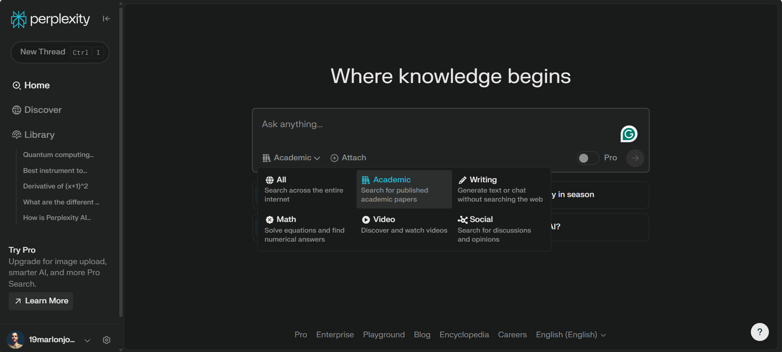
Perplexity AI for academic research
Notes:
Perplexity AI
Perplexity AI is designed to access and retrieve real-time data from the internet, allowing it to provide up-to-date information.
Think of it more like a search engine than a chatbot.
The free version of Perplexity is particularly useful for academic research as it provides in-built options to that allow you to narrow your searches to scholarly sources.
As a bonus it also connects to wolfram alpha so you can solve maths problems.
Sadly, we don’t have the time to take a deep dive into Perplexity today, but if you do want to learn more about this platform, I’ve included some introductory tutorials in the workshop resources.

Slide 20
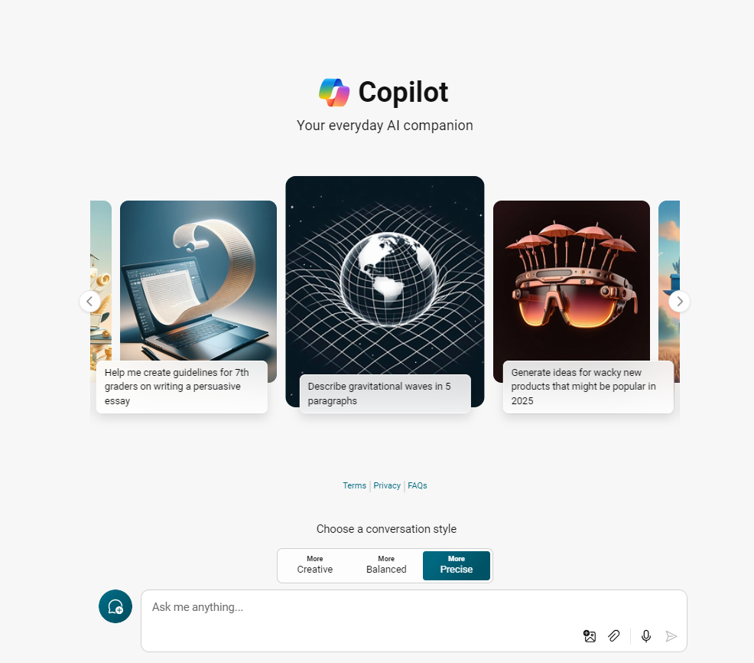
Get started with Copilot
To access the Copilot chatbot go to https://copilot.microsoft.com/
Login with SCU details
Notes:
How to use Copilot
Ok with the time we have remaining I want take a closer look at Microsoft Copilot.
To access the Copilot chatbot go to https://copilot.microsoft.com/.
Sign-in using your SCU details to ensure you are taking advantage of the Commercial Data Protection features we discussed earlier.

Slide 21
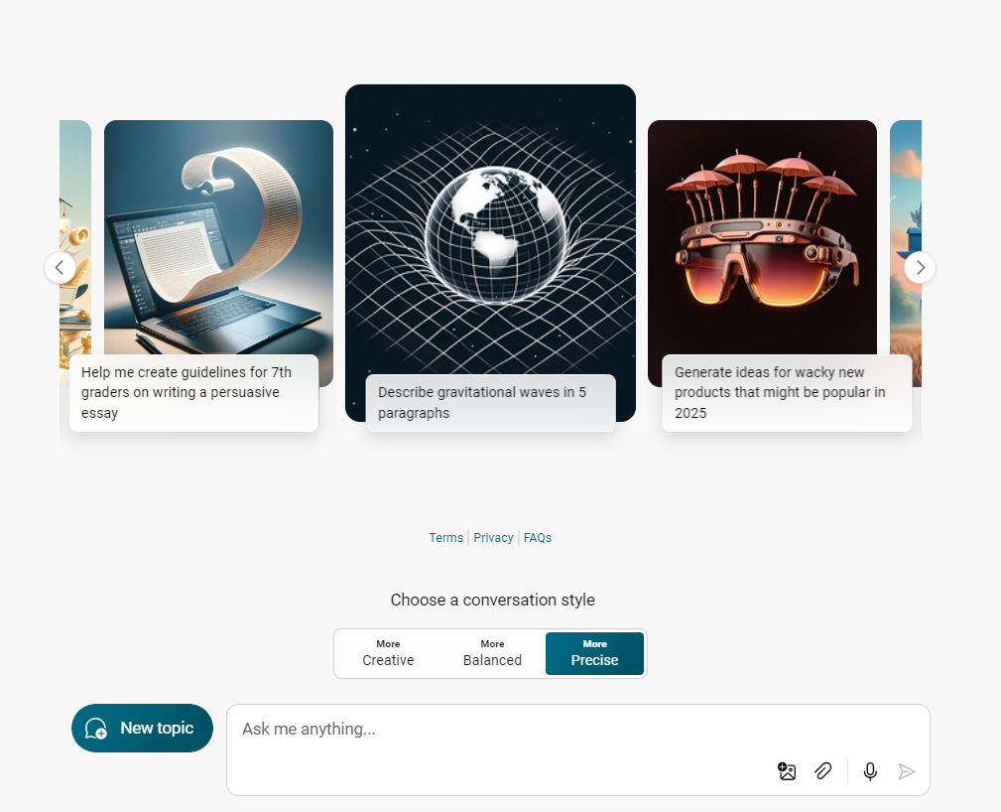
Copilot Interface
Notes:
How to use Copilot
As you can see, the Copilot chatbot interface is similar to ChatGPT. Enter your prompts in here, upload documents or add links here, start a new topic is here, access settings are here.
One thing that Copilot does do well is it gives you a built ability to adjust the accuracy randomness of the AI’s responses.
To do this, go to Choose a Conversation Style. Here you have three options are ‘Precise’, ‘Balanced’, and ‘Creative’
Use Precise when you want the AI’s responses to be more factually accurate.
Use Creative when you want responses that are imaginative and more elaborate.
Use Balanced when you need a mix of accuracy and creativity.
Typically, balanced mode use a combination of GPT 3.5 and GPT-4 models.
To get access to a faster models, select Creative or Precise, as these modes use a combination of the more advanced models, GPT-4 Turbo and Omni.
Let’s generate a response. You can see the response functions are similar to ChatGPT. Read aloud, regenerate etc
You can also see that Copilot provides web citations. Just take care here because Copilot is not actually accessing real-time data. Like ChatGPT, it’s training is static, so the output might not be current or correct.
You may have noticed too this number down here below the AI’s response (e.g. 1 out of 30). This number refers to the number of turns remaining in the conversation. A turn is either a prompt from me or a response from the chatbot. So, the limit for this conversation is 30 turns. After which, you’ll have to start a new conversation.
In Copilot, you have a prompt limit of around 4000 characters. If that’s to constrictive, you can switch to Notebook. Here you can write much more detailed prompts. I think the limit is around 18,0000 characters. I don’t tend to use Notebook, because I find it’s easier just to upload a file.

Slide 22
Should I use SCU’s Copilot?
PROS
Cons
Data Security
Faster Model
Web search capabilities
Image generation
No Chat History
Chat limits
No Sharing
Not integrated with MS 365
Notes:
Limited Functionality
So, as I mentioned earlier, Copilot is the platform SCU would prefer you to use when working with protected or sensitive data.
It is more secure than ChatGPT, however, the trade-off for that security is you lose some functionality.
Here’s what you can’t do with your SCU Copilot:
You won’t be able to save your conversations. There is no Chat History. Once you finish a conversation, that information is deleted. So, remember to save your prompts.
Copilot won’t remember anything about you. Each time you start a new conversation, you’ll need to reinput any information you want the AI to know.
You can’t create URL links or share chats. The only way to share, is to export each the individual response or take a screenshot.
You have a limited number of images you can generate.
You can’t access plugins, which means you can’t create songs. (i.e. Suno)
Another thing it’s important for to understand is that even though SCU has enabled commercial data protection in Copilot, SCU does not have a Copilot Enterprise Subscription.
For your purposes, this means that you can only access Copilot through web-browser (Edge or Chrome).
You won’t be able to access Copilot within your Microsoft 365 apps such as Word and Outlook. I think that’s a bit of a shame, since the integration between Copilot and Microsoft 365 app is one of Copilot’s best features.
Copilot’s is much safer in terms of data security, and it does use a more advanced AI model.
Another positive for Copilot is that it has the ability to reference web content. You’ll see the citations listed just beneath the AI’s response. That said, unlike Perplexity, Copilot is not actually accessing real-time data. Like Chat GPT, Copilot’s training data is static, meaning the information it provides might not always be current.
Image generation actually belong somewhere in the middle. While your SCU Copilot account can generate images, I’ve found this function to be unreliable. If you switch over to a personal Microsoft account, you’ll tend to get better image generation results.
Cons
On the cons side, you’ll notice that when you use Copilot with your SCU account:
You won’t be able to save your prompts or conversations. There is no Chat History. Once you finish a conversation, that information is deleted. (Remember to save your prompts)
Copilot won’t remember anything about you. So, each time you start a new conversation, you’ll need to reinput any information you want the AI to know what project you are working on.
You can’t create URL link to your chats in. Meaning the only way to share a conversation, is to export each the individual response or screenshot.
You can’t access Plugins, which means you can’t create audio or song. (i.e. Suno)
Another thing it’s important for to understand is that even though SCU has enabled Commercial Data Protection in Copilot, SCU does not have a Copilot Enterprise Subscription.
For your purposes, this means that you can only access Copilot through web-browser (Edge or Chrome). You won’t be able to access Copilot within your Microsoft 365 apps such as Word and Outlook. I think that’s a bit of a shame, since the integration between Copilot and Microsoft 365 app is one of Copilot’s best features.

Slide 23
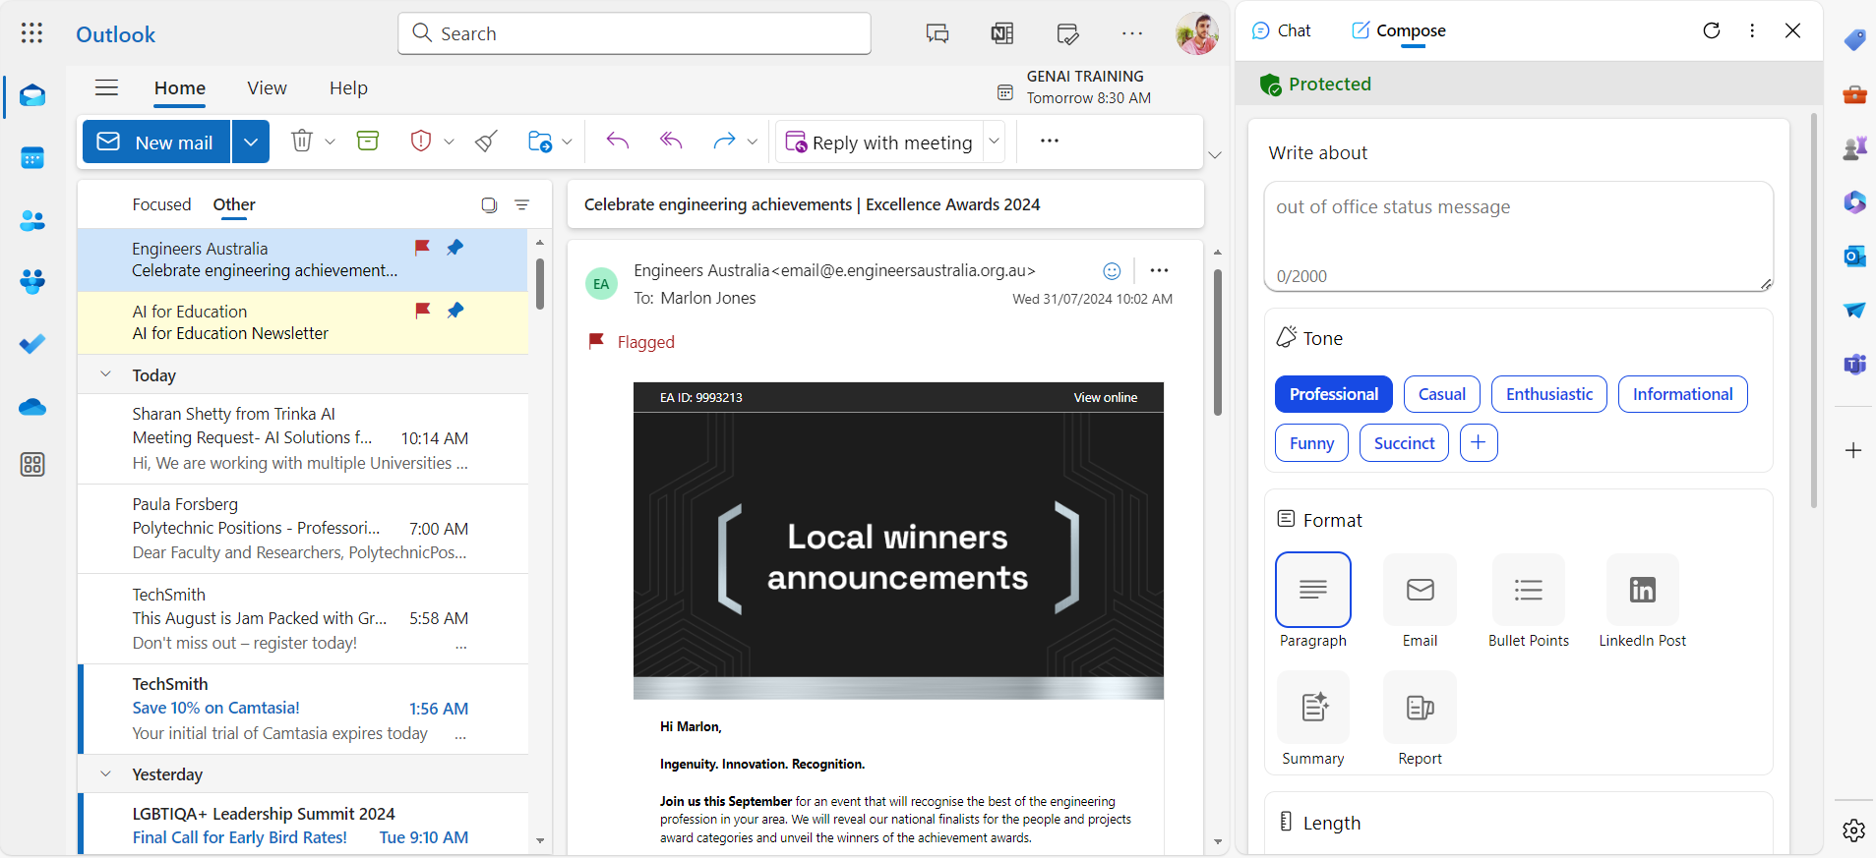
Copilot for Outlook
Notes:
Using Copilot in MS Edge
That said, even though Copilot is not integrated with your 365 apps, you can still use Copilot to assist you with your Outlook emails. Let me show you how.
Here I’ve opened the Edge Web browser and my online Outlook email.
In Edge, you’ll see the Copilot logo at the right of the screen. Click that to open the Copilot pop up.
Now, I’m going to use Copilot to generate a page summary. Here is the summary of the email.
Then I’m going to prompt the AI to generate a reply.
Alternatively, you can switch to the ‘Compose’ tab.
Here we can use the pre-set options to compose an email. [Write an email to my boss to explain that I wont be coming to work on Friday].

Slide 24
Claude Interactive Artifacts
Notes:
Claude
Very quickly, I want to show you this 1-minute clip which demonstrate the Claude. Because I think it’s a game changer for a lot of the online course development work many of you do.
Claude has just released a feature called artifacts. This feature allows you create code-based interactive such as web-pages, quizzes, data visualisations, games and much more in seconds, no coding knowledge required.
Here is a quick demonstration of Claude Artifacts.

Slide 25
Support, Resources and Questions Southern Cross University
Notes:
Support
Ok so we’re out of time today. I’ve not doubt that you’ll have a lots of questions about the tools and SCU’s broader organisational and pedagogical approach. So where can you go? A couple of places:
Contact Technology Services for Microsoft and Copilot support
Contact CTL for assistance incorporating AI into Teaching and Learning.
SCU’s AI Community of Practice
Resources
Don’t forget to check out the Padlet. Please note that you’ll have access to the Padlet is time limited, you’ll have about 3 months before the link breaks, after which time I everything in AI will have probably changed anyway.
Q&A
That’s all from me today, so thanks for coming and for your attention. If you’d like to get in contact with me, you can reach me at the Centre for Teaching and Learning.
Happy to take some questions.

