Slide 1
SCU College presents:
Strategies to empower students in their understanding of academic integrity
“Academic integrity means acting with the values of honesty, trust, fairness, respect and responsibility in learning, teaching and research” (Universities Australia, 2017, p. 4).
Dr Suzi Syme, College Director of Teaching and Learning Dr Liz Goode, PSP UA, Communicating at University Dr Michael Brickhill, Diploma Program, Quantitative Concepts for Business
Photo by Green Chameleon on Unsplash
Talking Teaching Webinar 14 October 2020
Notes:
Hello great to see you at our College presentation on strategies to empower students in their understanding of academic integrity. For our students in the College the two main academic integrity issues are plagiarism and collusion. The strategies we are presenting today have had a significant impact in the reduction of academic integrity cases for these two breeches.
I’m Suzi Syme D T&L and I’m presenting with my colleague Dr Liz Goode from our enabling program, the Preparing for Success Program
And Dr Michael Brickhill from our Diploma programs.
NEXT SLIDE

Slide 2
Acknowledgement of Country
I acknowledge and pay respect to the ancestors and descendants of the Lands upon which we work, meet and study.
I am mindful that within and without the buildings, the Land always was and always will be Aboriginal Land.

Slide 3
SCU Academic Integrity Framework
Increase in reported incidents of academic integrity at SCU and in broader community
Gaps in prevention of academic integrity breaches, including through curriculum design and education of both staff and students
Need for:
an educative and consistent approach across the University for both staff and students
embedded academic integrity principles and practices within the curriculum and pedagogy
strategies to enhance the confidence of teaching staff
Talking Teaching Webinar 14 October 2020
Notes:
A new working committee on academic integrity at the University has found that while our rules on academic integrity are working quite well overall, there is still a gap in preventing breeches of academic integrity as made clear by the increase in cases.
It has also become clear that we need an educative and consistent approach across the University for both students and staff.
I’m sure that many of us here today have taken on a new class where our students seem to have a different understanding of how the academic misconduct rules apply to them.
One of the ways to create a consistent understanding across the University is to build a community of best practice where we share examples of how to embed principles and practices within curriculum and pedagogy that work with our students. NEXT SLIDE

Slide 4
Principle 5: Engage and empower students
“An emphasis should be on active, participatory learning rather than relying on passive discovery” (Universities Australia, 2017, p. 7).
How?
Curriculum design
Clarity in expectations, modelling and consequences
Opportunities for students to practise academic integrity & take responsibility
Personalised response for assistance (Bretag, McNeill, Curtis, & Slade, 2019)
Prompt and timely feedforward (Kift, 2009)
Underpinning all our strategies is an educative approach
Notes:
In this presentation we focus on Principle 5 from Universities Australia on academic integrity to engage and empower students, where the emphasis is “on active, participatory learning rather than relying on passive discovery’ as research has shown this approach is the most effective in preventing academic breeches.
The strategies we are showcasing today have shown up to a 100% reduction in cases and are easily transferable across disciplines.
In the College we implement these strategies through a scaffolded approach with clearly modelled expectations built into curriculum design. Students have opportunities to recognise and apply good academic practices as well as identify examples of academic misconduct. We have found having a personalised response for assistance in understanding academic misconduct works well for our students, too which I will discuss later on our presentation.
NEXT SLIDE

Slide 5
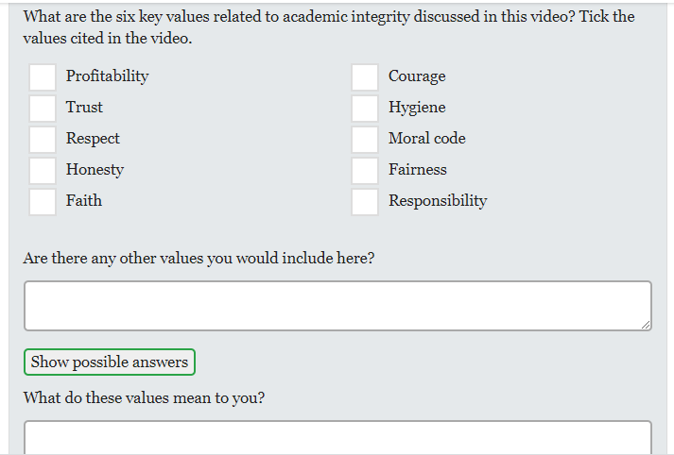
Strategy 1: Holistic approach embedded in curriculum design
Relate academic integrity to general principles of respect, fairness, honesty, trust, courage & responsibility
Students watch videos followed with activities and discussion
Video 1: discusses underlying principles https://www.youtube.com/watch?v=4aCRYFzhlBY&feature=youtu.be
Video 2: what academic integrity means to students https://www.youtube.com/watch?v=Z3yvl3im7oM&feature=youtu.be
Video 3: why students breach academic integrity from students’ perspectives
https://www.youtube.com/watch?v=Vu53kphkJLA&feature=youtu.be
Notes:
The next two strategies are in the first unit PSP students take, Managing your Study. This is a core unit that lays the foundations for these novice students to understand university conventions and practices. We start with activities that are designed to raise awareness of what academic integrity actually means and how it may relate to them.
They watch a series of videos that start with broad concepts of integrity such as fairness, honesty, respect etc linking to their own sense of integrity as well as to their future degree and reputation of the University.
They then move on to clips of students from diverse cultural backgrounds talking about their understanding of academic integrity and their experience of academic misconduct.
You can see here they have a tick box while they are listening to the video which helps them focus and then they are asked some deeper more reflective questions after the video that are discussed in class. NEXT slide

Slide 6
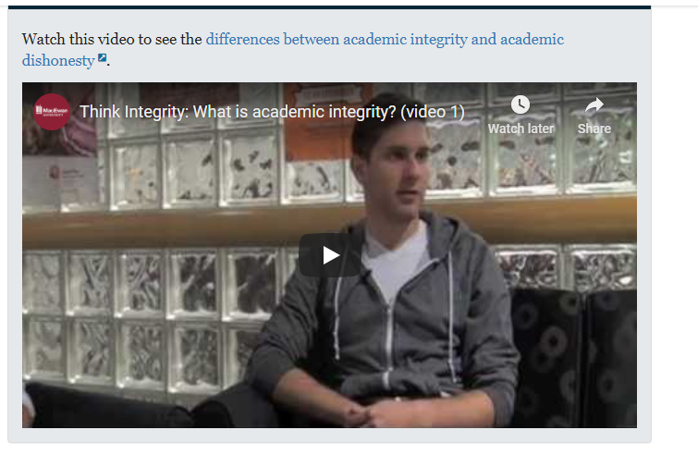
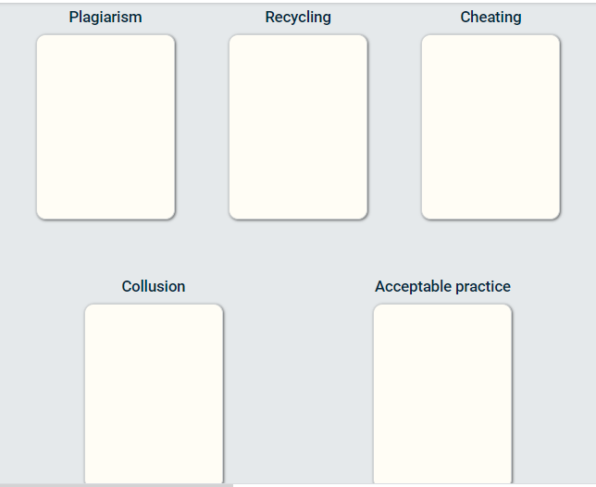
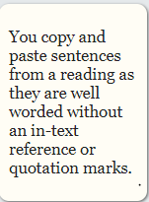
Embedded activities
Notes:
This is a card game to engage students so that they become familiar with the different terms related to academic misconduct.
We discuss in tutorial which ones they got right and where there may have been some hesitation.
Next slide

Slide 7
Strategy 2: Scenarios and discussion
Scenario two
You are a new student and finding university study challenging. Your family is interested in your studies, and really proud of your achievements. All through your life your parents and sisters have helped you with your studies, you discuss your classes and assignments at the dinner table every night.
You enjoy sharing the new ideas and information you are learning at university with your family, and you find talking about assignments with your sisters helps you to better understand the topic. You also find it is helpful to read your final drafts of assignments out-loud so that your family can tell you if it makes sense and flows well. Is it OK to get this type of support from your family?
It is NOT OK to get this kind of support from your family. You cannot discuss assignments or get feedback on assignments because it needs to be all your own effort.
It is OK to talk about your studies and assignments with others, including your family. We often deepen our understanding by talking to others and hearing other points of view.
It is a good idea to include your family in your studies, including discussing new ideas and assignments so long as you write the assignment yourself.
Both B and C.
Notes:
This is one of the scenarios that students work through together in pairs or groups.
Students recognise situations in which they may well find themselves.
They discuss possible answers to multiple choice questions so that they are clear about what is acceptable and what is not acceptable.
In the case presented here it means they are empowered to get the support they need while being clear about boundaries with their family and friends of what is and is not acceptable.
Liz will now present two strategies she uses in her writing unit in the PSP.

Slide 8
In-class activities
Discuss: Is this appropriate; why/why not?
Problem solve: What steps could you take to fix it?
Practise: Suggest alternative words and phrases; rework the sentence structure
Notes:
Hello everyone. I teach into a PSP unit called Communicating at University. In this unit, we aim to work through real-world scenarios similar to what Suzi has described, but also include activities focused around Turnitin – how to use it, how to interpret it, and how to act on Turnitin reports to fix any issues.
So there are a variety of short examples we work through at various points in the session – this is just one example. Others are entirely highlighted, some have references, some don’t, some have highlighting that is perfectly acceptable – just as you might see in your own Turnitin report.
Throughout the session we aim to frame Turnitin as a positive and useful tool for students to check their draft work – like a spell check but for integrity. We frame these in-class exercises as authentic activities – so you’ve just submitted this draft to Turnitin, and you get this back. What do you do?
For these scenarios we discuss – what’s ok about this, what’s not, and why? We talk about steps to fix it, if it needs fixing; and then we practise doing that. So ultimately we mirror, unpack and practise what students need to do for their own assignments, keeping things as simple and uncomplicated as possible.
NEXT SLIDE

Slide 9
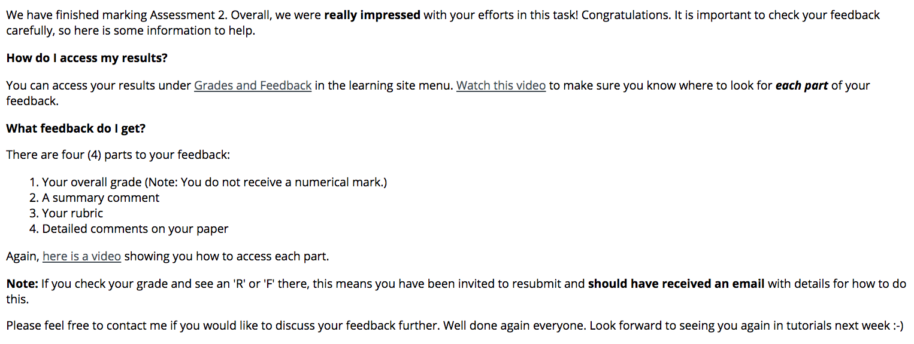
Ensuring students read their feedback…
Notes:
Hello everyone. I teach into a PSP unit called Communicating at University. In this unit, we aim to work through real-world scenarios similar to what Suzi has described, but also include activities focused around Turnitin – how to use it, how to interpret it, and how to act on Turnitin reports to fix any issues.
So there are a variety of short examples we work through at various points in the session – this is just one example. Others are entirely highlighted, some have references, some don’t, some have highlighting that is perfectly acceptable – just as you might see in your own Turnitin report.
Throughout the session we aim to frame Turnitin as a positive and useful tool for students to check their draft work – like a spell check but for integrity. We frame these in-class exercises as authentic activities – so you’ve just submitted this draft to Turnitin, and you get this back. What do you do?
For these scenarios we discuss – what’s ok about this, what’s not, and why? We talk about steps to fix it, if it needs fixing; and then we practise doing that. So ultimately we mirror, unpack and practise what students need to do for their own assignments, keeping things as simple and uncomplicated as possible.
NEXT SLIDE

Slide 10
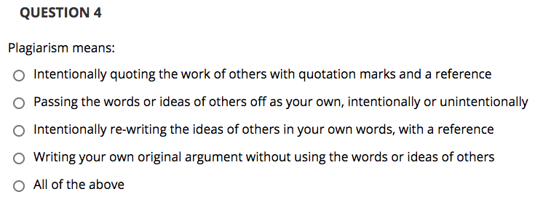
Strategy 3: Practising integrity – Assessment quiz
10 randomly-selected multiple-choice questions, one hour, open week 3
Feedback after the due date
Supplemented with in-class activities
Notes:
In week 3 of the unit, so fairly early on, we assess their understanding of these foundational principles and practices through a multiple choice quiz.
So there are stakes involved, which compels students to focus on and seek to understand academic integrity before they submit their first written assessment - but they are low stakes. The quiz is worth 10%, and students have an hour to complete 10 questions, with only one attempt allowed.
Students do very well in this quiz – the average mark across some 1200 students so far is 9.2/10. The idea is not to trick or trip up, but to allow students to test their understanding of general principles, how to recognize appropriate and inappropriate integrity, and their recognition of referencing conventions.
Students gain feedback and hopefully confidence through their results – and thereby learn within a structured, scaffolded and educative framework.
I’ll now pass on to Michael, who will explain some of the scenarios used in a mathematics unit.
NEXT SLIDE

Slide 11
Strategy 4: Inquiry based modelling: Collusion example
The difference between
Collusion & Collaboration
Exemplar Question provided to work on at home as part of preparations for mid-session assessment task
Students work on this for 2-3 weeks, then bring their answers to class in readiness for a discussion surrounding level(s) of presentation for their assessment….
However, this discussion has a dual purpose…..
Notes:
Hi everyone. I am the Unit Assessor and lecturer for MAT10706 Quantitative Methods with Economics, which is a core first year first session unit in the Diploma of Business and an elective the Bachelor of Business and the Bachelor of Information Technology.
In this unit, there is a mid-session assessment task due in Week 7, worth 30%, which requires students to apply skills from the first 5 weeks of content to solve quantitative questions, presenting calculations and explanations.
To assist students to prepare for this task, an exemplar question is provided a month prior to the due date. Students develop their responses to this exemplar and then bring it along to discuss in the Week 6 tutorial (the last one before the due date). The exemplar and the tutorial discussion have a dual purpose …… to address presentation and for students to discover what collusion is and come to their own conclusions about what it looks like and what it means.
NEXT SLIDE

Slide 12
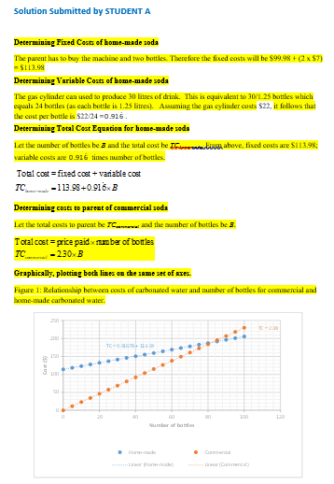
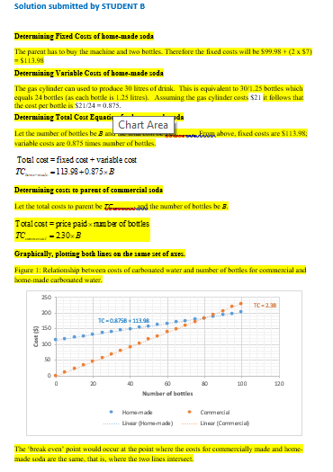
Strategy 4: Inquiry based modelling: Collusion example
The difference between
Collusion & Collaboration
4. Students are presented with mock student submissions
Students asked inquiry-based questions:
Check the mathematics – is it correct?
Check the presentation of the graphs – is anything missing?
Compare all submissions against each other. Can you see anything that is not quite right about these submissions?
6. Students come to their own conclusions about COLLUSION
Notes:
When students arrive for the Week 6 tutorial, they are presented with some mock student submissions. They are then given 15 – 20 minutes to look at these submissions and respond to the three inquiry-based questions listed here;
Check the mathematics – is it correct?
Check the presentation of the graphs – is anything missing?
Compare all submissions against each other. Can you see anything not quite right about these submissions?
From this checking and comparing, students discover and comment upon similarities evident between mock submissions and then make their own conclusions and tell the tutors and each other - in their own words - what they think is going on, that is, that these submissions reflect students working too closely together and then submitting largely identical work. This is collusion.
I’ll now pass back to Suzi, who will outline the personal assistance we provide to students in relation to academic integrity breaches within SCU College units.
NEXT SLIDE.

Slide 13
Strategy 5: Personalised assistance
Shown allegation and determination letters in tutorial
Encouraged to contact AIO if receive an allegation
Guided by AIO’s conversational inquiry approach
Provided with opportunity to learn from errors with a Resubmit
In class: Discuss exemplars
Shown example AI letters
If receive allegation, encouraged to contact AIO
Inquiry based conversation
Ensure understanding
Resubmit for a Pass
Notes:
We familiarise our students with the consequences and the process, should they breech academic integrity rules.
We show them the allegation letter in tutorial so that it doesn’t come a surprise/shock and encourage them to seek support by contacting the AIO.
THE AIO takes an inquiry based conversational approach with the student asking questions for example why do you think you have received this letter, what do the coloured lines mean, what do you need to do instead so by the end of the phone they know exactly what they need to do. This approach is both empowering and educative for students.

Slide 14
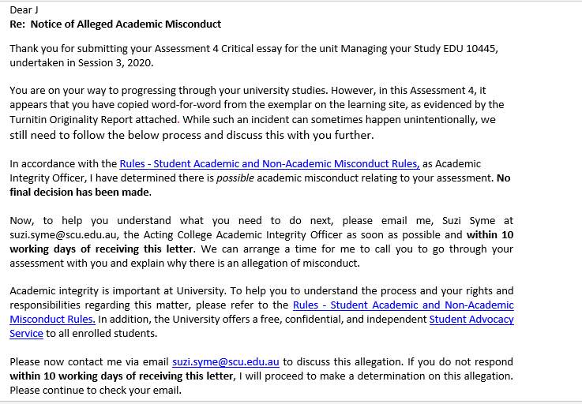
Allegation Letter
Notes:
This is an example allegation letter. You can see how the language is positive and accessible for novice non traditional students like our PSP students to understand the contents of the letter.
The impact of the strategies has been significant as is demonstrated in the next slide.
NEXT SLIDE

Slide 15
Impact of strategies
Academic Integrity cases for EDU10446 and MAT10706 from S1 2018 till S2 2020
 |  | No of Allegations / No. of Submissions | Relative Frequency (%) | Copying word for word from other source (incl. patchwork plagiarism) | Collusion | Copying word for word from example/study guide | Provide assignment to other student | Work written by someone else (incl. ghost writing) | Recycled previous assignment | Allegation Dismissed | Zero marks
 | EDU10446
 | S1 2019 | 34 / 1032 | 3.3 | 23 | 5 | 1 |  | 2 | 1 | 2
 | Quiz Introduced
 | S2 2019 | 11 / 668 | 1.7 | 5 | 3 |  |  |  | 3
 | S3 2019 | 5 / 478 | 1.1 | 4 | 1
 | S1 2020 | 14 / 947 | 1.5 | 12 | 1 |  |  |  | 1
 | S2 2020 | 10 * / 744 | 1.3 | 5 | 5
 | MAT10706
 | S1 2018 | 21 / 120 | 17.5 | 2 | 17 |  | 2
 | Collusion Activity Introduced
 | S2 2018 | 18 / 110 | 16.3 | 2 | 15 |  |  |  | 1
 | S3 2018 | 0 / 46 | 0 | 0 | 0
 | S1 2019 | 5 / 134 | 3.7 | 0 | 4 |  |  |  |  | 1
 | S2 2019 | 2 / 67 | 3.0 | 0 | 2
 | S3 2019 | 3 / 36 | 8.3 | 0 | 3
 | S1 2020 | 4 / 69 | 5.8 | 0 | 1 |  | 2 |  |  |  | 1
 | S2 2020 | 0 / 54 | 0 | 0 | 0
* End-of-session marking not yet complete at time of presentation.
Notes:
LIZ
So after the introduction of the assessed quiz in session 2, 2019, you can see a consistent drop in the percentage of integrity cases among submissions, from around 3% in session 1 2019 down to between 1-1.7% in subsequent sessions, often from among 500-1000 submissions in a session.
MICHAEL
Since the introduction of the collusion awareness activity in Session 2 2018, both the number and relative percentage of students referred for investigation has trended downwards, with zero referrals being made in two sessions.
SUZI
Today we have presented several strategies that engage and empower our students in their understanding of academic integrity which have had a significant impact on the reduction in cases suggesting they have been effective. We hope these strategies might be useful for you in your unit or course.

