Slide 2
Teaching online tutorials:
an adaptive model to encourage student engagement
Emma Babbage
School of Law and Justice

Slide 3
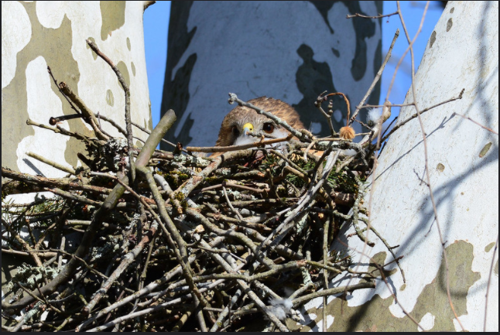
Overview
Scaffolded model
Discussion
Q&A

Slide 4
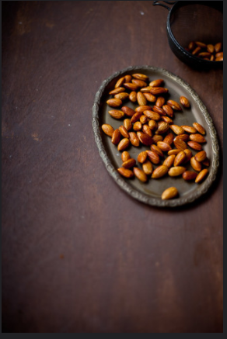
1. Activate prior learning
Establish a connection
Brainstorm and allocate jigsaw discussion
Fast fire chat box drill
True/ false poll
Multiple choice anonymous
Multiple choice chat box & rationales
Phone a friend
Pictionary prompts
Scaffolded guides

Slide 5
Topic 6: Introduction to Trusts
Week 6
LAW72009 Principles of Equity
Tutorial via Collaborate Ultra
Emma Babbage

Slide 6
Overview
Prior learning about trusts
T6 tutorial guide
T6 tutorial questions
Summary

Slide 7
1. Prior learning about trusts

Slide 8
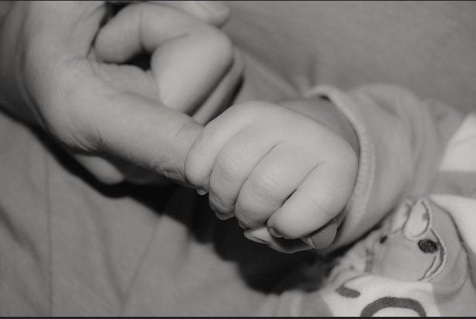

Slide 9
Relevant remedies
Original jurisdiction remedies: equitable cause of action
Auxiliary jurisdiction remedies: common law cause of action
Injunction
Account of profits
Equitable compensation
Constructive trust
Injunction
Account of profits
Equitable damages
Specific performance
Equitable interest → original jurisdiction → original jurisdiction remedies
Mere equity or personal equity → auxiliary jurisdiction → auxiliary jurisdiction remedies

Slide 10
Lecture Slide 3
Introduction [20.1-20.3]
A trust exists when the beneficial ownership of property is separated from the legal ownership of the property
The notion of separating title from beneficial ownership is the heart or the trust relationship

Slide 11
Lecture Slide 4
Elements of a trust [20.4-20.9]
Three essential elements to a trust relationship:
The trustee – a legal person who holds a vested legal title (or a vested equitable title) in the property, subject to fiduciary duties;
Trust property – property in real or personal form which is identified or ascertainable and capable of being held on trust. The trust property can be legal or equitable property; and

Slide 12
Lecture Slide 5
Elements of a trust [20.4-20.9]
The beneficiary (sometimes referred to as the cestui que trust in older cases, or the object of the trust in modern cases) – a person, or group of persons, who hold a beneficial equitable estate in the property and on whose behalf the trustee must act

Slide 13
2. T6 Tutorial Guide
See Word document:
Unit Content > TUTORIAL QUESTIONS SESSION 2 2020 > Emma’s tutorial documents > T6 Tutorial Guide

Slide 14
2. Engage students in activities with accountability

Slide 15
2. Engage students in activities with accountability
E.g. multiple choice quiz for exam prep
Jigsaw discussion
Problem questions/ application questions
Time limits
Pauses
Check ins
Role play/ argue/ predicting

Slide 16
3. T6 Problem Questions
Unit Content > TUTORIAL QUESTIONS SESSION 2 2020 > Topic 6 Intro to Trusts
Relevant cases:
McPhail v Doulton [1971] AC 424 (HL)
Re Baden Deed Trusts (No 2) [1973] Ch 9 (CA)
Re Tuck’s ST [1978] Ch 49
R v District Auditor Ex p West Yorkshire MCC (1986) 26 RVR 24

Slide 17
McPhail v Doulton [1971] AC 424 (HL)
In 1941, Bertram Baden executed a deed settling a non-charitable trust for the benefit of the staff of Matthew Hall & Co Ltd and their relatives and dependents.
The objects clause of the deed provided that:
“The trustees shall apply the net income of the fund in making at their absolute discretion grants to or for the benefit of any of the officers and employees or ex-officers or ex-employees of the company or to any relatives or dependants of any such persons in such amounts at such times and on such conditions (if any) as they think fit.“
Baden died in 1961.
The validity of the trust was challenged on the basis that the objects of the trust were insufficiently certain.

Slide 18
McPhail v Doulton [1971] AC 424 (HL)
Lord Wilberforce noted the fact that the settlor had left his property on trust, with instructions to distribute according to the trustees’ choices.
This meant that the trust property was not to be distributed equally among the beneficiaries.
in McPhail the House of Lords restated the law, abandoning the “complete list” test in favour of an “is or is not” test.
Lord Wilberforce phrased the new test of certainty for beneficiaries as: “Can it be said with certainty that any given individual is or is not a member of the class.”

Slide 19
Discuss the validity of the following clauses in Henry Brown’s will:
“I give $500,000.00 to my wife in trust to be distributed among any persons that she may choose”.

Slide 20
“I give $ 500,000.00 to my wife to be distributed among such of my employees and relatives that she may choose in her absolute discretion”.
“I give $ 500,000.00 to my wife to be distributed among Roman Catholics living in our housing estate, as she may choose. If she is in doubt whether a resident is a Roman Catholic, she may get a ruling from the Parish Priest”.
“I give 500,000 to the Secretary of the Labor Party to be distributed in his absolute discretion among deserving residents of NSW”.

Slide 21
“I give $10000 to my trustee to be distributed among all those persons who attended my Christmas party, whose names are recorded in my diary”.
Assume that the trustee has ascertained the names and addresses of all those who are entitled to share the money, and that a cheque sent to one of those was returned with “No such person at this address. Return to sender”.
Advise the trustee.

Slide 22
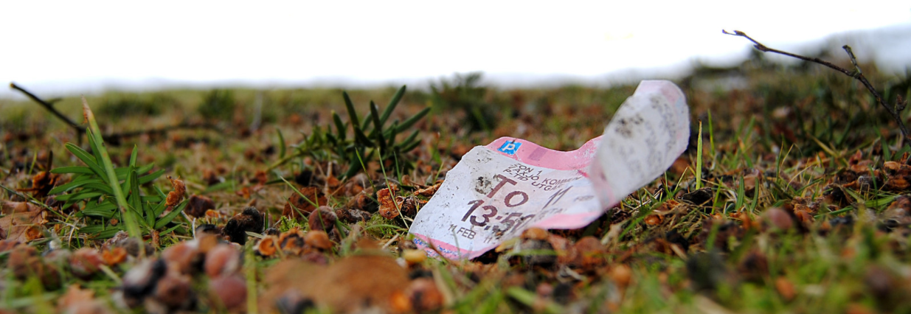
3. Gain a snapshot understanding of students’ learning

Slide 23
3. Gain a snapshot understanding of students’ learning
Writing (the minute paper): chat box
Most important take-away and why
Summary questions
Extension exercises
Confidence rating

Slide 24
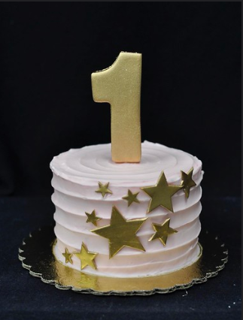
4. Summary
Write 1 point of knowledge you have learnt from topic 6.
Why is this point important?

Slide 25
Next steps: Week 6
Prepare for Thursday night Q&A with Rohan Price @ 7pm Thursdays
Consolidate your learning on Topic
See you after Study Week!

Slide 26
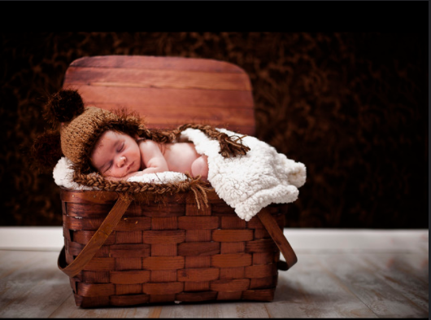
Develop your toolkit with confidence

